Slide 1
CSE231 – Digital Logic Design
Single-bit Adder Circuits
and
Multi-bit Adder Circuits

Slide 2
Single-bit Adder Circuits
The Half Adder (HA)

Slide 3
Binary Addition
0 0 1 1
+ 0 + 1 + 0 + 1
0 1 1 10
Sum
Carry
Sum

Slide 4
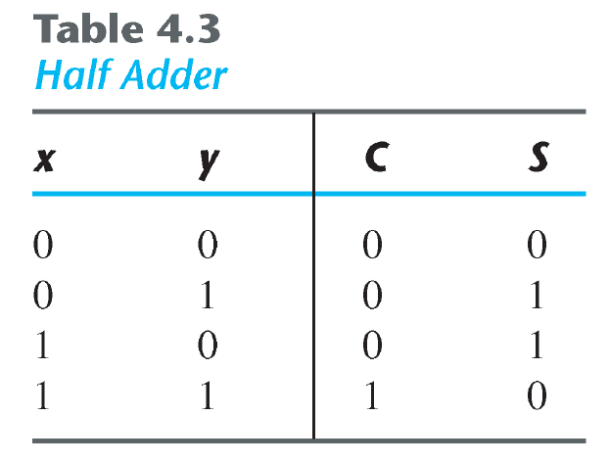
The Half Adder

Slide 5
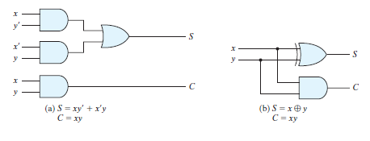
The Half Adder

Slide 6
Single-bit Adder Circuits
The Full Adder (FA)

Slide 7
Binary Addition
0 0 0 0
0 0 1 1
+ 0 + 1 + 0 + 1
0 1 1 10
Carry-in
1 1 1 1
0 0 1 1
+ 0 + 1 + 0 + 1
1 10 10 11
Carry-out
Sum

Slide 8
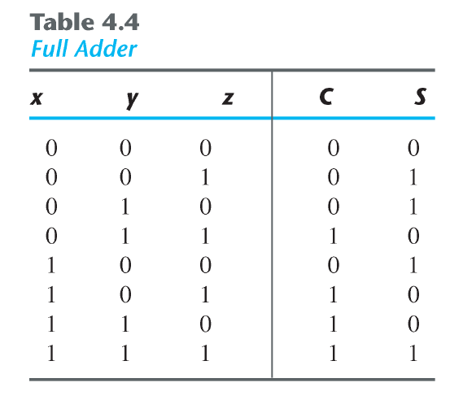
The Full Adder
Cin
Cout

Slide 9
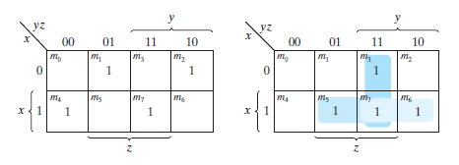
The Full Adder
S
Cout
Cin
Cin
Cin
Cin
S = X xor Y xor Cin
Cout = X.Y + X.Cin + Y.Cin

Slide 10
The Full Adder
X
Y
S
Cin
Cout

Slide 11
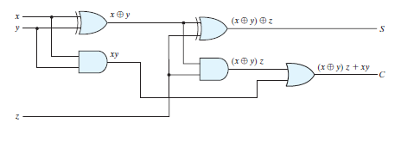
The Full Adder
Half Adder
Half Adder
Cin
Cin
Cin + xy
Cin
Cout=(X’Y+Y’X) Cin +XY
=X’Y Cin +XY’Cin+XY
=X’Y Cin+ X(Y+Y’Cin)=X’Ycin+X(Y+Cin)= X’Ycin+XY+Xcin
=Y(X+X’Cin)+Xcin=Y(X+Cin)+Xcin=XY+Ycin+XCin

Slide 12
X | Y | Z | Cin | Cout | S
0 | 0 | 0 | 0 | 0 | 0
0 | 0 | 0 | 1 | 0 | 1
0 | 0 | 1 | 0 | 0 | 1
0 | 0 | 1 | 1 | 1 | 0
0 | 1 | 0 | 0 | 0 | 1
0 | 1 | 0 | 1 | 1 | 0
0 | 1 | 1 | 0 | 1 | 0
0 | 1 | 1 | 1 | 1 | 1
1 | 0 | 0 | 0 | 0 | 1
1 | 0 | 0 | 1 | 1 | 0
1 | 0 | 1 | 0 | 1 | 0
1 | 0 | 1 | 1 | 1 | 1
1 | 1 | 0 | 0 | 1 | 0
1 | 1 | 0 | 1 | 1 | 1
1 | 1 | 1 | 0 | 1 | 1
1 | 1 | 1 | 1 | ?? | 0
S | 00 | 01 | 11 | 10
00 |  | 1 |  | 1
01 | 1 |  | 1
11 |  | 1 |  | 1
10 | 1 |  | 1
C | 00 | 01 | 11 | 10
00 |  |  | 1
01 |  | 1 | 1 | 1
11 | 1 | 1 | X | 1
10 |  | 1 | 1 | 1
S=X XOR Y XOR Z XOR Cin

Slide 13
Multi-bit Adder Circuits

Slide 14
Implementations of Multi-bit Adders:
1. Ripple Carry Adder
2. Carry Lookahead Adder

Slide 15
Multi-bit Adder Circuits
Ripple Carry Adder

Slide 16
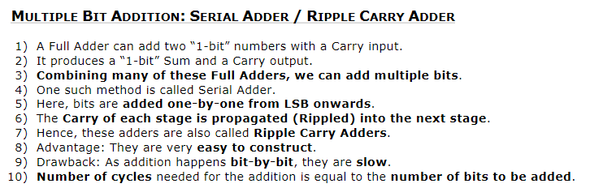
Slide <number>

Slide 17
128 X128=7X128=
1024X1024=10X 1024
128= 7 bits→7 clock cycles
128+128
128+128
128+128

Slide 18
Ripple Carry Adder
Carry ripples from one column to the next
1
1
1
Carry-in
1
0
1
0
+
1
0
0
1
Carry-out
1
0
1
0
0

Slide 19
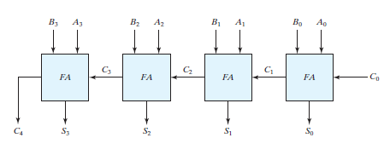
Ripple Carry Adder
Carry-out
Carry-in
Carry ripples from one stage to the next

Slide 20
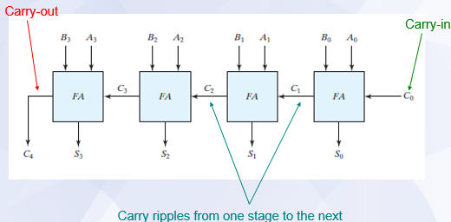
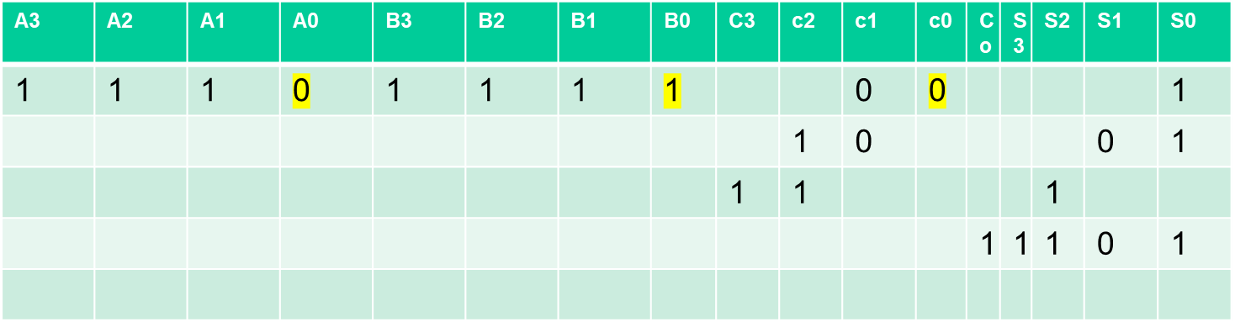

Slide 21
Ripple Carry Adder
n-bit Ripple Carry Adder
  Composed of n 1-bit Full Adders
  Carries ripple from LSB stage to MSB stage
    Delay ~ (n)*(delay of single FA stage)
    Area required is linear in n
4-bit Ripple Carry Adder
  Composed of 4 1-bit Full Adders

Slide 22
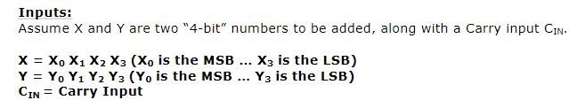
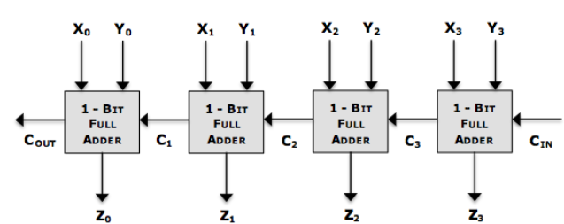
Each adder will require 1 clock cycle;4-bit adder requires 4 clock cycles
Slide <number>

Slide 23
128
+`128+128
128X128=8*127
(1024)^2

Slide 24
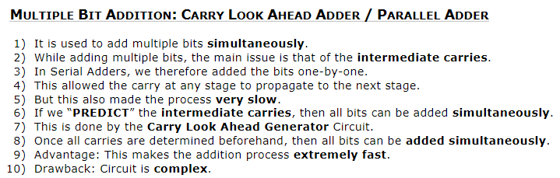
Slide <number>

Slide 25
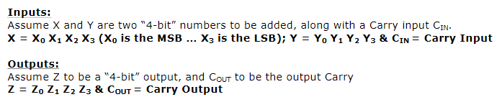
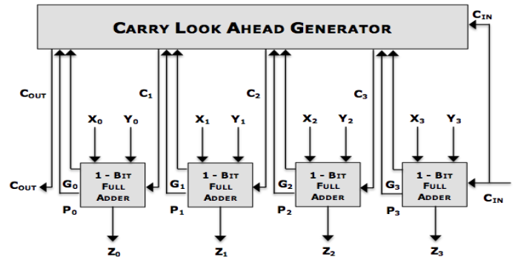
Slide <number>

Slide 26
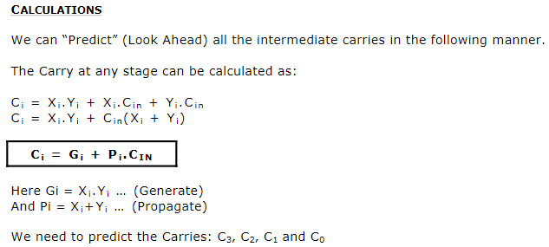

1Xi
1Yi
1Cin
Slide <number>

Slide 27
X5+Y5
X2
y2
X4
y4
X5
y5
X5Y5
6
5
4
3
2
1(LSB)
cIN
X=x0 X1 X2 X3 X4 x5 010000
Y=0111 11

Slide 28

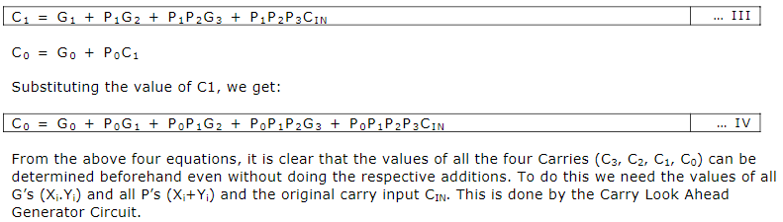
Slide <number>

Slide 29
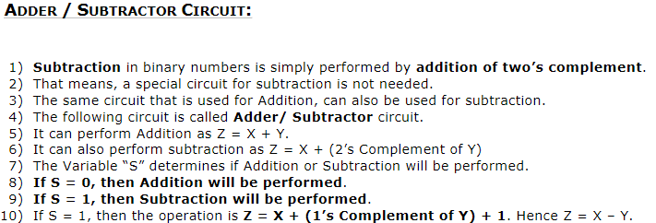
Slide <number>

Slide 30
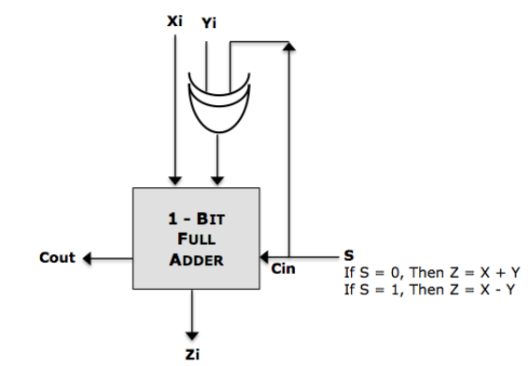
Slide <number>

Slide 31
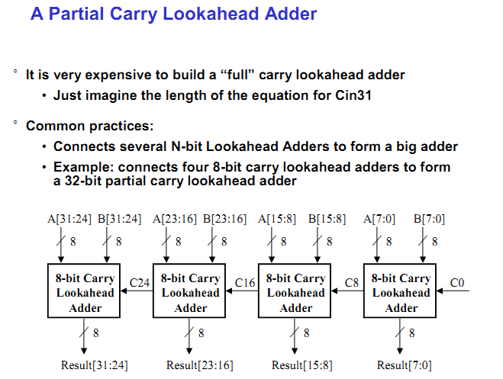

Slide 32
The Ripple Carry Adder is slow!
Why?
How can the speed of the adder be increased?

Slide 33
Increasing the speed of the Adder
Method A: Include all inputs and outputs in the design
  Inputs = X_{i}, Y_{i}, C_{in,i}; Outputs = S_{i}, C_{out,i}
    1-bit 3 inputs 2 outputs
    2-bit 5 inputs 3 outputs
    4-bit 9 inputs 5 outputs
    n-bit 2n+1 inputs n+1 outputs
  Large number of operands, but only 2 logic levels
    Increase in speed
    Increase in area required
Use Truth Table
and K-Map to
derive logic functions
decrease propagation delay
increase # of logic gates

Slide 34
Increasing the speed of the Adder
Method B: Manipulate the Boolean Algebra
(results in the design of the Carry Lookahead Adder)

Slide 35
Multi-bit Adder Circuits
Carry Lookahead Adder

